Slide 1
Offensive Technologies
CCTF
Defense Presentation
Group 3
Monday 20 December 2021

Slide 2
19-11-2021
CCTF Resilient

Slide 3
CCTF Resilient
Context
Goals
Strategy
Configuration
Tools and scripts
Results
Improvements

Slide 4
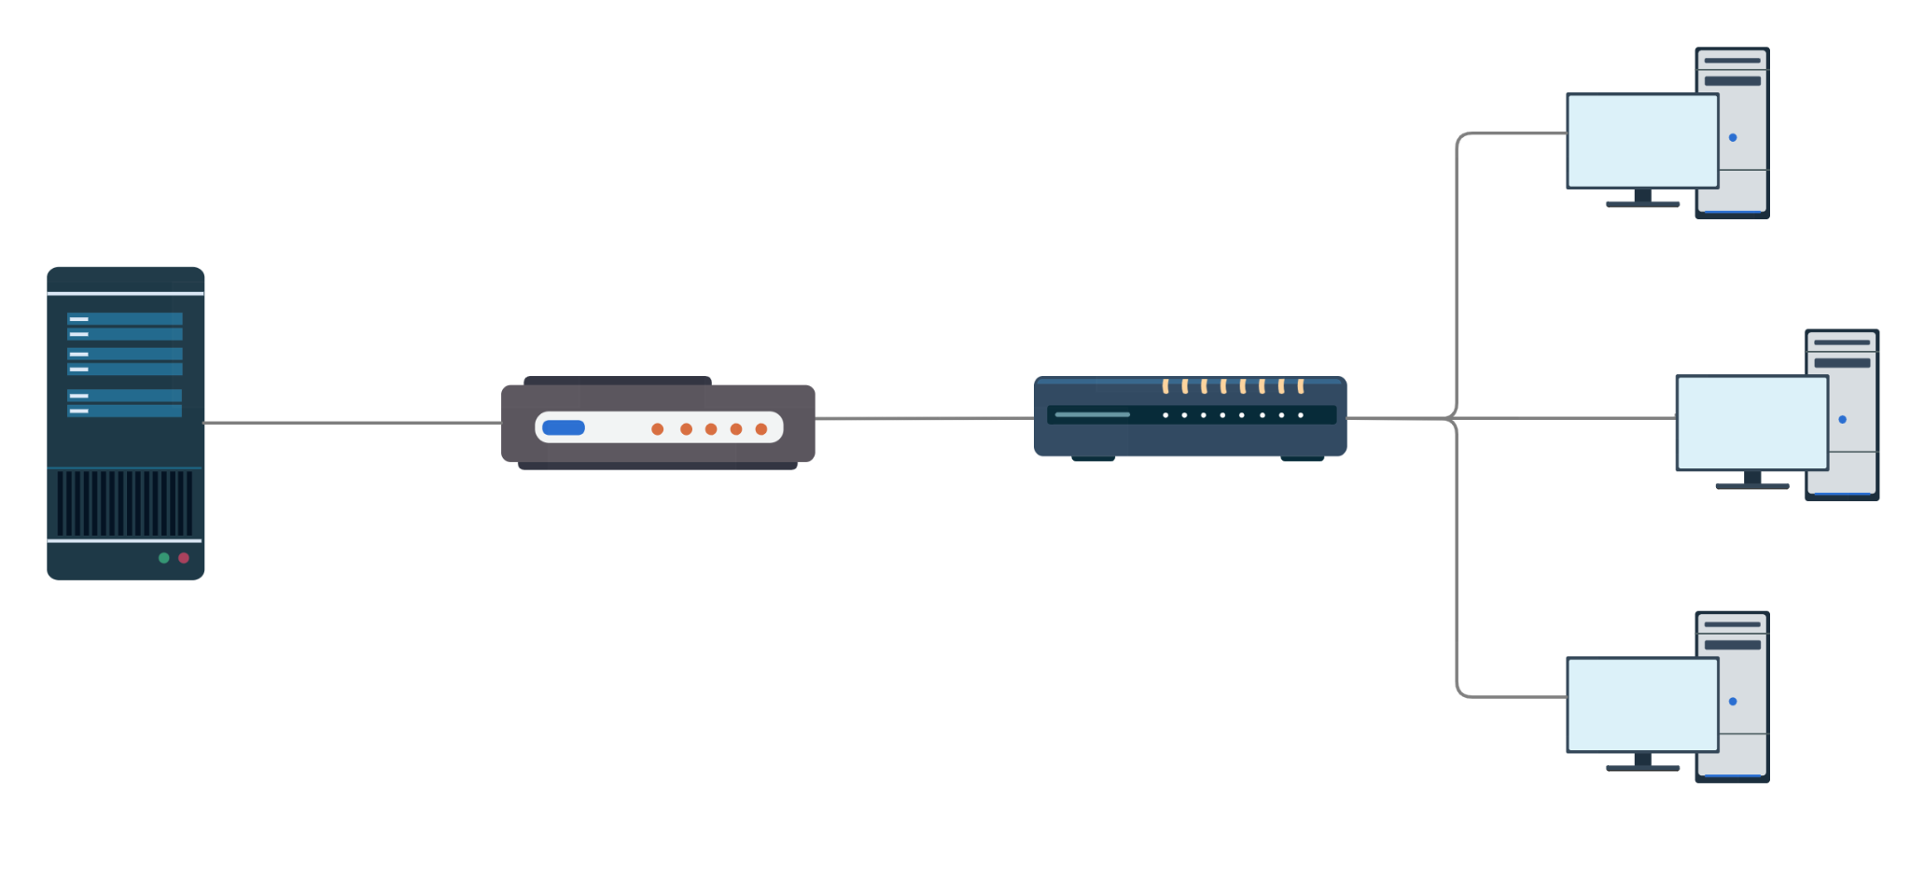
Context

Slide 5
Goal
Guarantee server response time < 500ms
Block unexpected traffic
Block unauthorized access
Monitor the network
Traffic as UDP, ICMP and other unwanted traffic should be blocked
The access to the server and the gateway must be protected
Constantly check what is happening on the network to detect any attack

Slide 6



Strategy
Gateway hardening
Network monitoring
Implement a set of rule on the gateway to create a robust firewall
Continuously check incoming traffic and periodically check if the server was up and running
Server hardening
Update Apache, install Varnish and configure them properly

Slide 7


Configuration
Server
Gateway
TCP/IP stack hardening
Up-to-date Apache
Up-to-date Varnish
Live traffic monitoring
Firewall rules (iptables)
TCP/IP stack hardening
Live traffic monitoring

Slide 8
Hardening (1/2)
Tweaking TCP memory parameters following CISCO guidelines for 1Gbps connection
Reduced TCP timeouts and retries
Bigger TCP network queue
Different TCP congestion control algorithm (BBR)
TCP/IP stack

Slide 9
Hardening (2/2)
Static RAW table rules to block
ICMP
UDP
Fragmented IP packets
Bogus TCP flags
Mangle table rules to block
Invalid packets
Weird MSS values
Rate limiters
Firewall

Slide 10
Varnish
HTTP accelerator
Caching static content
Efficient on memory and CPU
Doubles as application level firewall
(filter only HTTP GET requests)

Slide 11
Monitoring (1/3)
Where? | server, gateway
What? | checks the incoming traffic, identifying protocol and source IP
How? | using the pyshark module and listening on the network interface
traffic_logger.py
Where? | server
What? | check the response times of requests filtering ones above a given threshold
How? | looking at the log of Varnish which was set to save such times
apache_logger.py
Notes:
Lorenzo

Slide 12
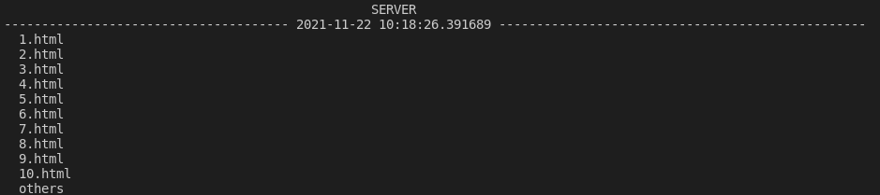
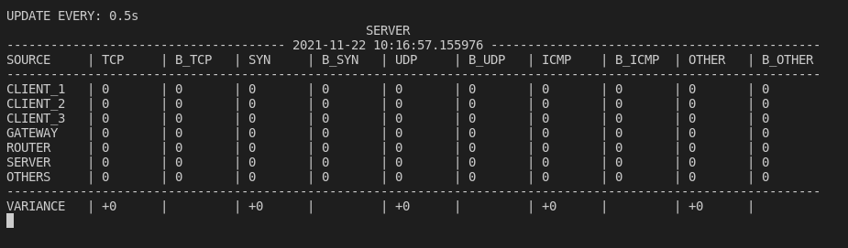
Monitoring (2/3)
Where? | server
What? | checks incoming requests identifying the requested page, the number of time it was requested and the source IP
How? | using the pyshark module and listening on the network interface
server_logger.py
Notes:
Lorenzo

Slide 13
Monitoring (3/3)
What worked | What may be improved
All the log worked as expected The output was clearly readable A log of the output was saved for further analysis The first CCTF simulation allowed us to improve the script | The traffic logger weighed heavily on the performance A successful SYN flood was not clearly detected A better analysis of which traffic to filter needed to be done
Notes:
Lorenzo

Slide 14
Results
Attackers were not able
to DoS the server
for most of the time
We were able to identify and automatically stop most of the incoming attacks
Varnish caching was a game changer and drastically improved page serving times

Slide 15
Improvements
The defense could be described as successful, yet:
The iptables were misconfigured, we blocked any new incoming SSH connection to the gateway because of the MSS value
So for some time we were unable to access the gateway reducing our monitoring possibilities
Some key points that could be improved are:
Adaptive defense based on the attacker’s behaviour
Better configuration testing

Slide 16
10-12-2021
CCTF Secure Server

Slide 17
CCTF Secure Server
Context
Goals
Strategy
Configuration
Tools and scripts
Results
Improvements

Slide 18
Context

Slide 19
Goal
Guarantee server response time < 500ms
Fix the code
Block unauthorized transaction
Monitor database integrity
Fix the PHP code against SQL injection, XSS attack, invalid parameters or anything else
Avoid unauthorized bank transaction
The database must always have a consistent state.
We must record every changes made.

Slide 20

Strategy
Patch the application
Monitoring the database
The PHP source code was vulnerable to various attacks
Periodically check the database for inconsistencies
Server hardening
Configure the web-server and the database to improve security

Slide 21
Starting configuration
Server
Gateway
Up-to-date Nginx
PHP code refactored
Hardened Mysql
Live DB monitoring
Firewall rules (iptables)
Pyshark and dependencies installed
Live traffic monitoring

Slide 22

NGINX
Efficient web server
Hardened configuration
Application level firewall

Slide 23

Source code
String validation
Integer validation
Balance consistency check
Password hashing
Password policy enforcing

Slide 24

MySQL Hardening
Changed root password
Allowed only local access
Enforced the Principle of Least Privilege
using different users
Delay on failed login
Enabled MYSQL global log
Notes:
matteo

Slide 25
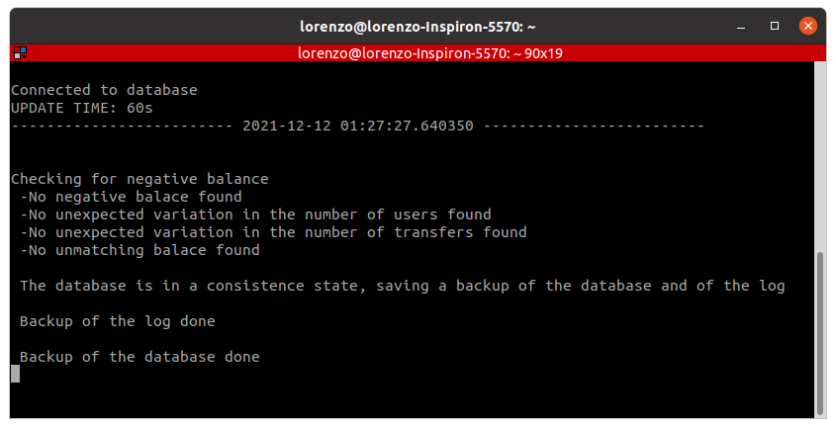
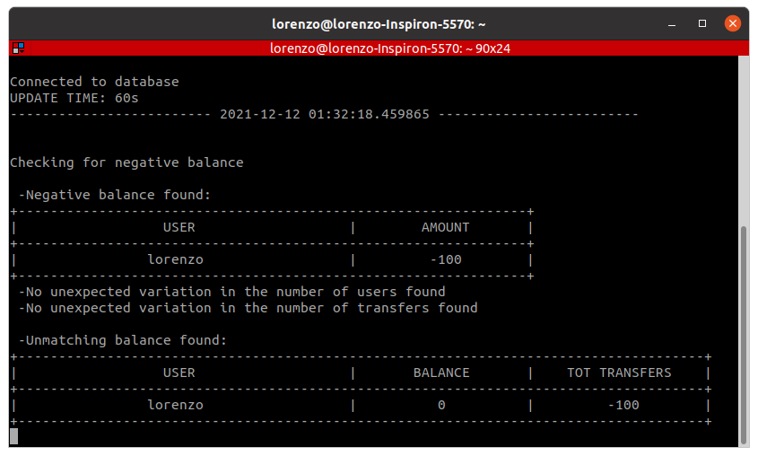
Scripts 1/2
Where? | Server
What? | Periodically check the consistency of the database Perform a dump of the database and a copy of the request.log file
db_check.py
Notes:
Lorenzo

Slide 26
Scripts 2/2
Where? | Server and Gateway
What? | Check the incoming traffic identifying the protocol and the source IP
How? | using the pyshark module and listening on the network interface
traffic_logger.py
What worked | What may be improved
Same as before No data was compromised | DPI for HTTP requests Automatize attacks identification Use Snort
Notes:
Lorenzo

Slide 27

Results
Attackers were not able
to compromise our server or our database
We always had updated backup of the most valuable file and information
We were able to patch almost all the vulnerabilities in the PHP code

Slide 28
Improvements
The defense could be described as successful, yet:
We missed the exponential log file DoS vulnerability
We blocked the gateway DNS traffic, cutting it out of the network
We noticed too late the NAT happening on the router
Some key points that could be improved include:
Incremental defense based on the behaviour of the attacker
Better testing of our defense

Slide 29
Thanks!

